Slide 1
Verification and Testing
Solution Package

Slide 2
Testing and Validation
A Test Plan is a grouping of Test Runs
A Test Run can be:
Are assigned to „Tester“ and „Test Reviewer“
Related to a Simulation and its results
Defined Test Procedures with recorded results
Run automated
Run step by step manually with automated results recording
Run step by step manually with manual results recording
Test Plan Templates
Optional Integration with Aras RE, SM, SA
Provide evidence that Requirements are satisfied by related Product Design
Evidences are the result of Test Runs.

Slide 3
Data Object Model
Prefix: vt_ (Validation and Testing)
from other Aras Apps
<<ItemType>>
vt_TestPlanTemplate
LifeCycle
<<ItemType>>
PhyicalPart
Test Plan ??
<<ItemType>>
sm_Task
<<RelationshipType>>
vt_TestPlanTempl_Run
<<RelationshipType>>
vt_sm_Task_ReqToValidate
LifeCycle
<<ItemType>>
Part
<<ItemType>>
sys_Function
<<ItemType>>
sys_SystemElement
<<ItemType>>
vt_TestPlan
Test Plan Types:
-Design Validation
-Physical Testing
Test Plan Execution ??
<<RelationshipType>>
vt_TestPlan_Run
<<RelationshipType>>
re_Part_Requirement
<<RelationshipType>>
vt_TestPlan_DependsOnRun
<<ItemType>>
Requirement
-Software v hardware
-Virtual v physical
-Manual v automated
LifeCycle
<<PolyItemType>>
sys_SolutionElement
<<ItemType>>
vt_TestRun
<<RelationshipType>>
sys_Reqt SolutionElement
“Satisfied By”
Test Run Types:
-Design Validation
-Physical Testing
Test Plan Execution ??
<<RelationshipType>>
vt_TestRun_ReqToValidate
<<RelationshipType>>
vt_ Reqt vt_ Reqt SolElement_TesRun_tgv
TreeGridView
“Test Runs”
<<RelationshipType>>
vt_TestRun_Result File
<<PolyItemType>>
sm_DesignRepresentation
<<File>>
<<RelationshipType>>
vt_TestRun_Step
LifeCycle

Slide 4
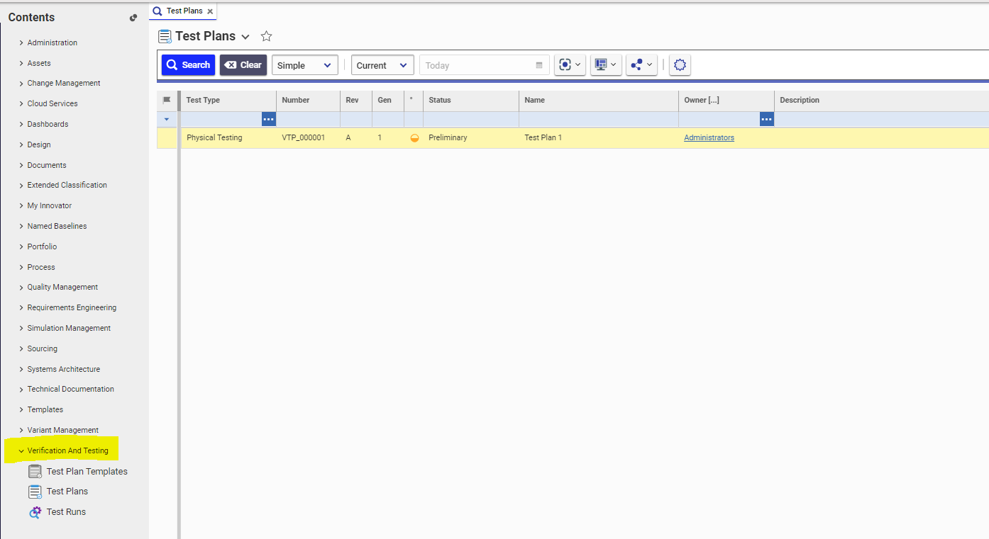
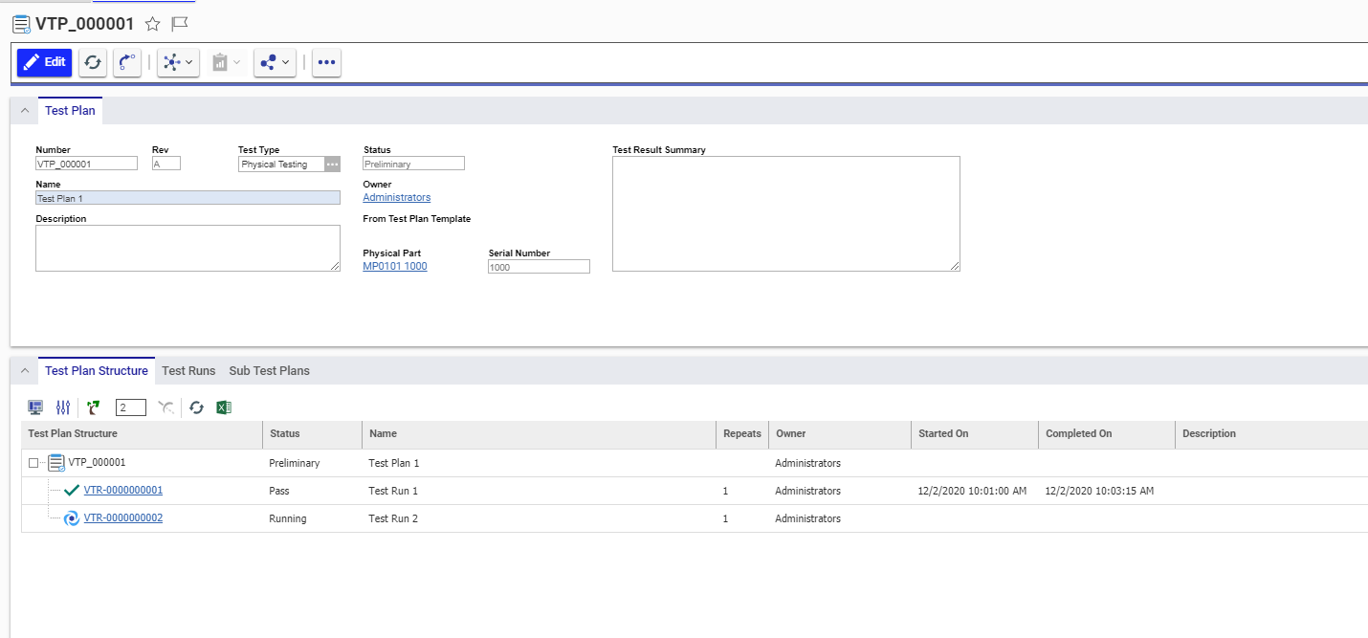

Slide 5
